Slide 1


STOCK MARKET PRICE PREDICTION
WITH BUY – SELL INDICATOR
Analyzing The Coca-Cola Company (Ticker: KO)
PRESENTED BY
- ROHAN KUMAR KATKAM
- BADRI NAGESHWAR AJAY
- YASHWANTH TADEPALLY
- NAGALAKSHMI PRASANNA MANNEM

Slide 2

3 | INTRODUCTION
4 | MAIN OBJECTIVE
5 | OVERVIEW OF DATA
6 | EXPLORING FINANCIAL DATA WITH TTR
7 | DATA VARIABLES & ANALYSIS
8 | MODELING APPROACH
10 | EVALUATION & RESULTS
12 | ADDITIONAL TASK
13 | TOLERANCE
14 | RESULTS
AGENDA
STOCK MARKET PRICE PREDICTION
Analyzing The Coca-Cola Company (Ticker: KO)

Slide 3

INTRODUCTION
Why It’s Crucial To Predict Price
About The Coca-Cola Company (KO)
What Motivates Us ? - Interest in understanding stock market trends and making informed investment decisions.
What Domain Focused
Who Cares About This Project ? - Investors, financial analysts, and individuals interested in stock market dynamics.
STOCK MARKET PRICE PREDICTION - Analyzing The Coca-Cola Company (Ticker: KO)
03

Slide 4
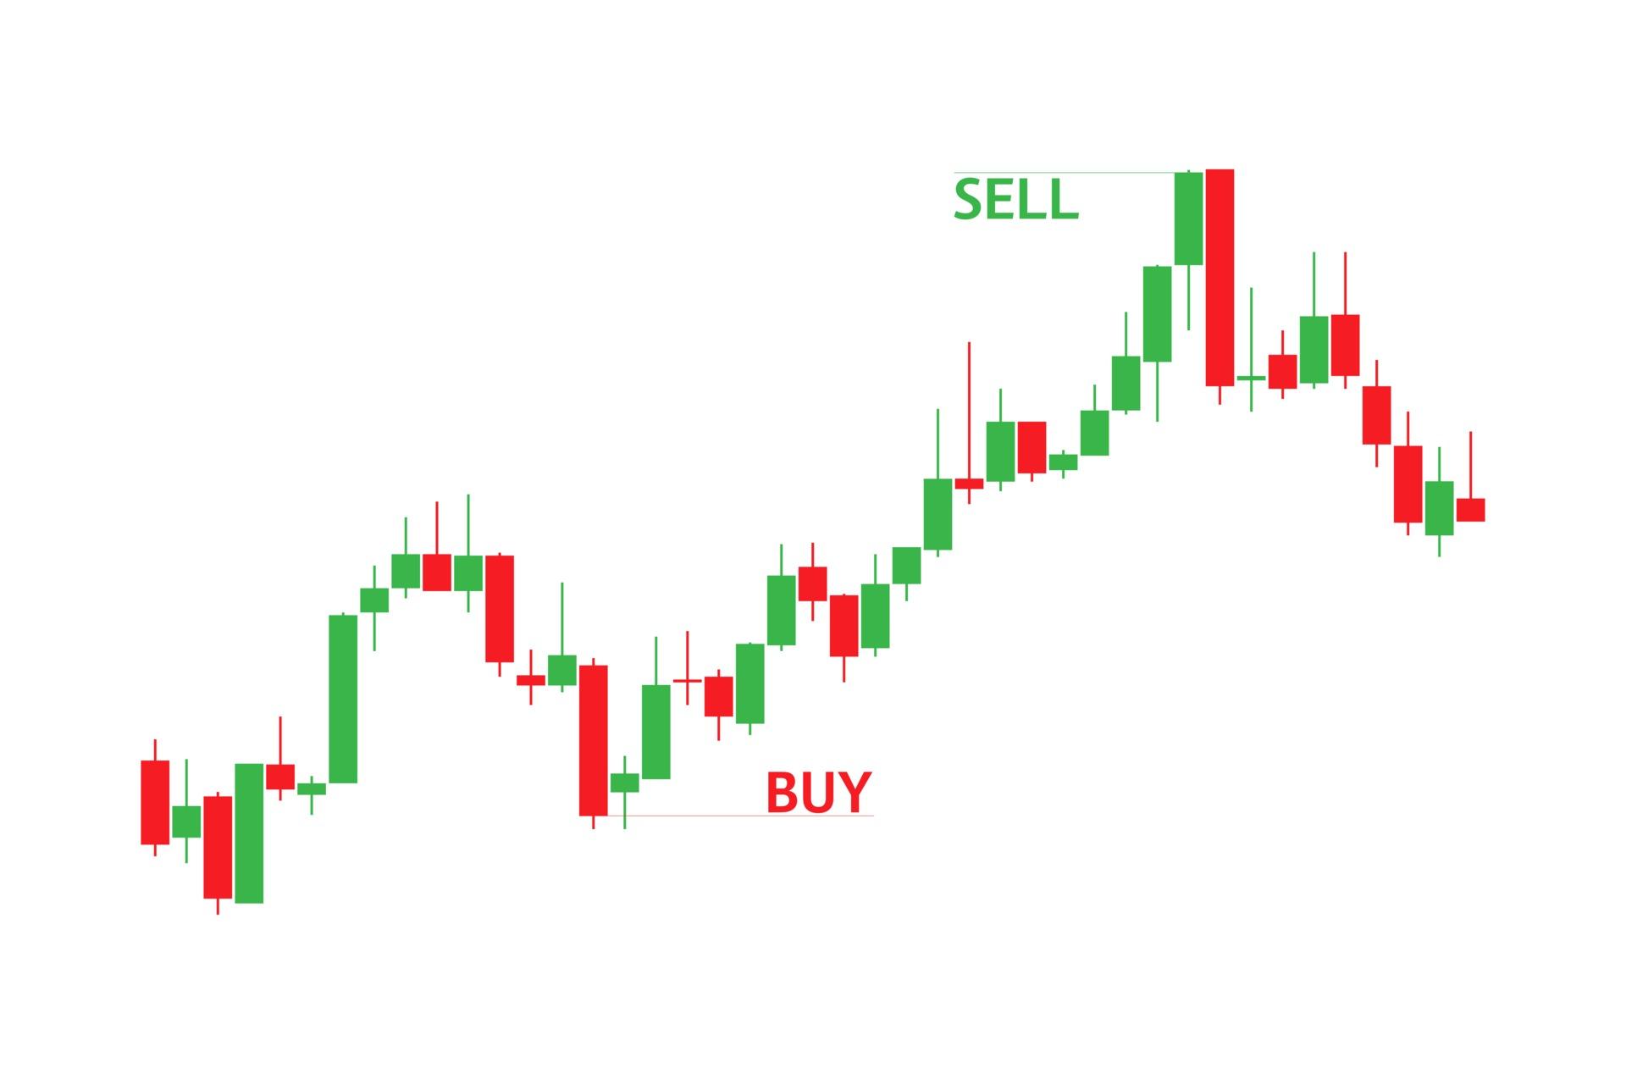
MAIN OBJECTIVE
WHAT WE ARE TRYING TO DO ?
Ultimately, the goal is to empower investors and financial analysts with a tool that can assist them in making informed decisions regarding their investments in various stocks.
OBJECTIVE STATEMENT
Analyze historical stock data for The Coca-Cola Company (KO) and develop a predictive model for stock price movements.
ADDITIONAL TASK
Develop a buy and sell indicator based on the predictive model to assist in investment decision-making.
TYPE OF PROBLEM
Time-series prediction. Why? Because we're predicting future stock prices based on past data.
"Understanding the complexities of the stock market can be challenging amidst the demands of modern life."
STOCK MARKET PRICE PREDICTION - Analyzing The Coca-Cola Company (Ticker: KO)
04

Slide 5
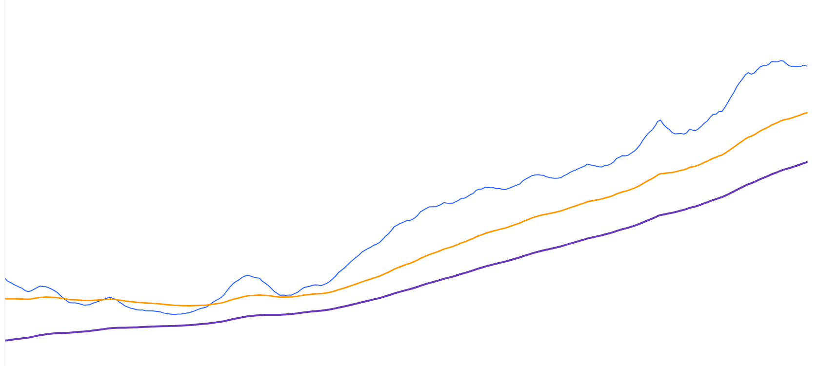
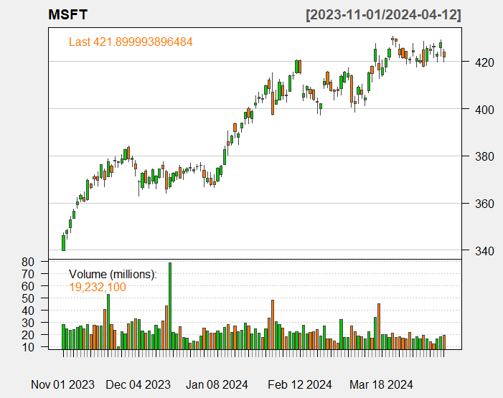
OVERVIEW OF DATA
A powerful R package for quantitative financial modeling, trading, and analysis.
Provides tools for fetching, analyzing, and visualizing financial data.
Exploring Financial Data with ‘quantmod’
Fetching Data
Technical Analysis
Visualization - Seamlessly integrate with ggplot2 for creating customizable and visually appealing plots.
Backtesting - Use chartSeries() function to visualize historical data alongside trading signals.
STOCK MARKET PRICE PREDICTION - Analyzing The Coca-Cola Company (Ticker: KO)
STOCK MARKET PRICE PREDICTION - Analyzing The Coca-Cola Company (Ticker: KO)
05
05

Slide 6

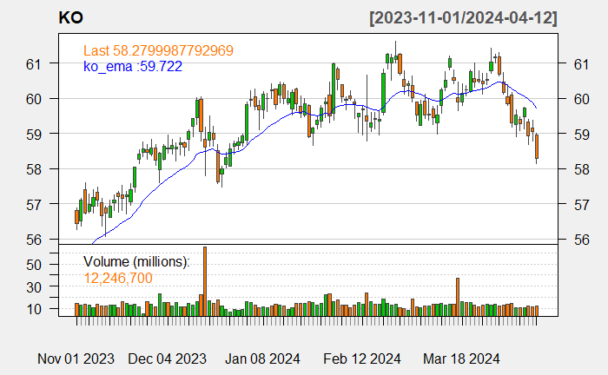
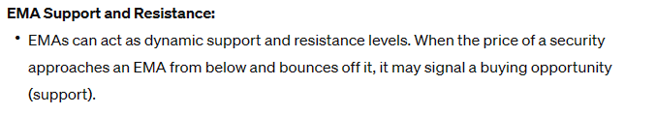


EXPLORING FINANCIAL DATA WITH TTR
TTR Documentation: Technical Trading Rules (TTR) Reference
Websites: quantmod GitHub Repository, TTR GitHub Repository
The TTR (Technical Trading Rules) package is an extension of quantmod focusing on technical analysis.
Offers a wide range of functions for calculating various technical indicators.
Understanding Exponential Moving Average (EMA)
USE CASES
Trend following strategies
Identifying support and resistance levels
Signal generation in trading strategies
STOCK MARKET PRICE PREDICTION - Analyzing The Coca-Cola Company (Ticker: KO)
06

Slide 7
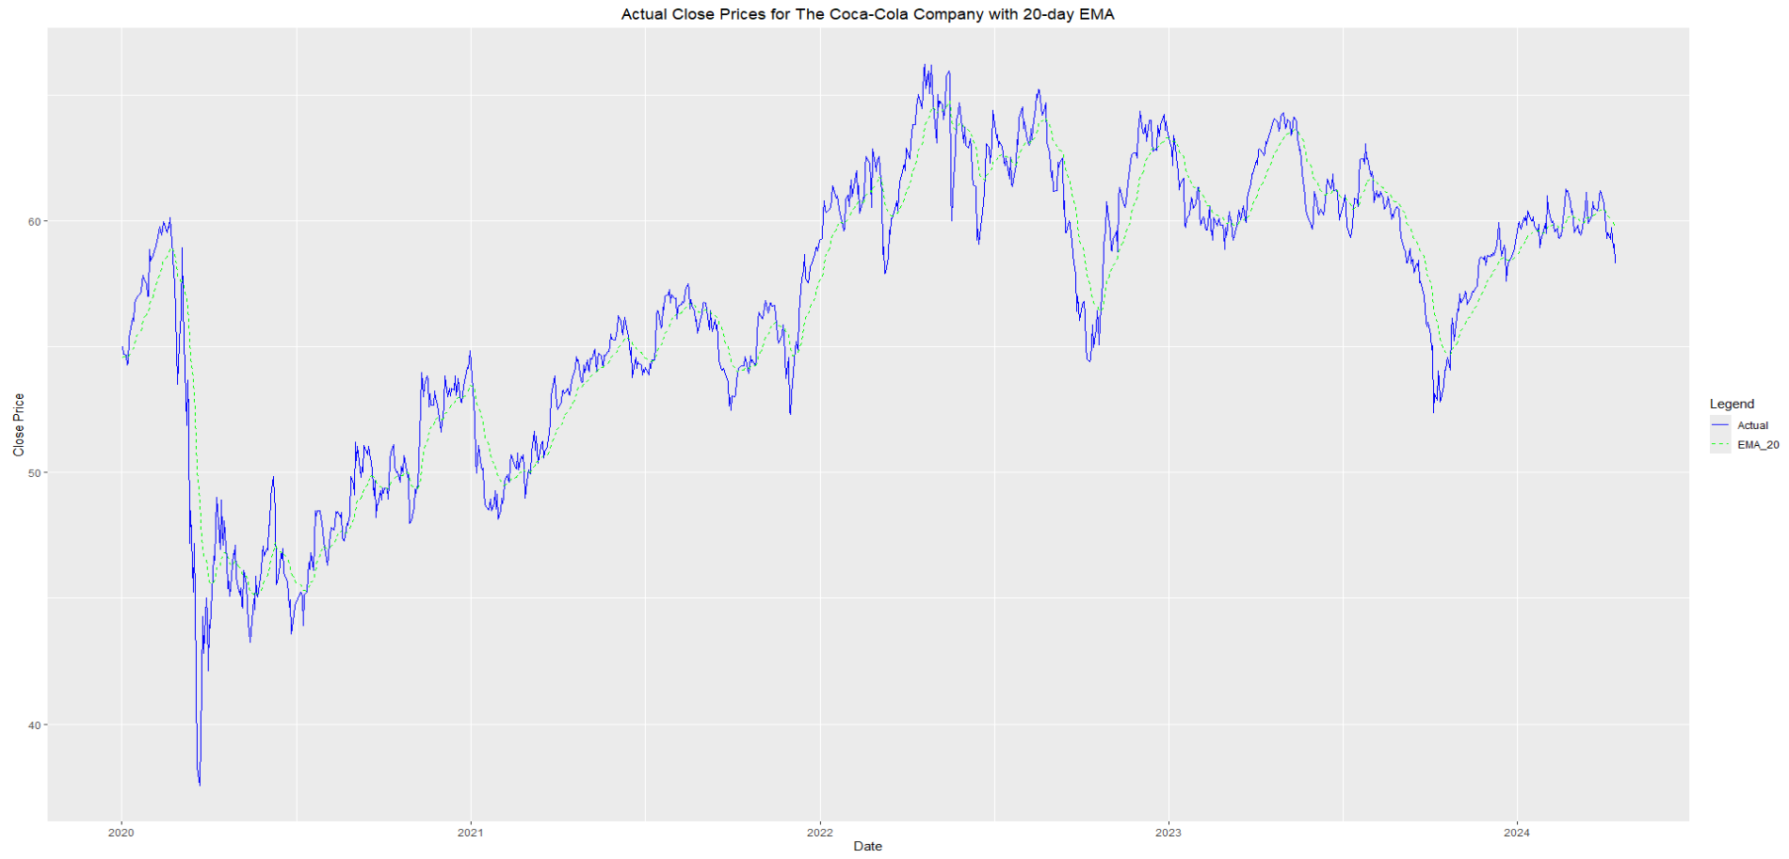
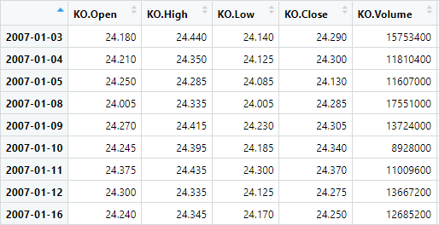
MODELING APPROACH
Linear Regression
Why? Simple and Interpretable Model for Predicting Stock Prices
Training Set:
Data Before 2020
75.2% of the Entire Dataset
Used to Train the Linear Regression Model
Actual Close Prices for The Coca-Cola Company with 20-day EMA
Test Set:
Data From 2020 Onwards
24.79% of the Entire Dataset
Used to Validate the Performance of the Trained Model
STOCK MARKET PRICE PREDICTION - Analyzing The Coca-Cola Company (Ticker: KO)
07

Slide 8
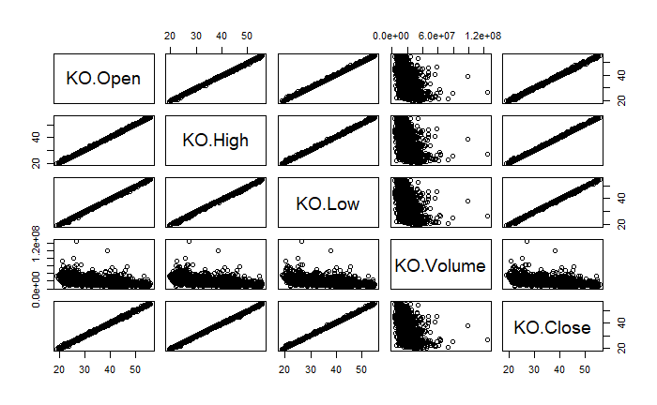
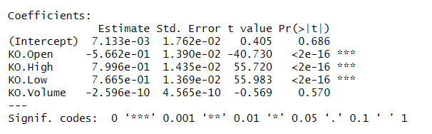
DATA VARIABLES &
ANALYSIS
PREDICTORS – Open.KO, High.KO, Low.KO, Volume.KO
RESPONSE – Close.KO
DOMAIN KNOWLEDGE
Financial modeling, trading volume is often considered an important factor in predicting stock prices, still be practically significant.
STOCK MARKET PRICE PREDICTION - Analyzing The Coca-Cola Company (Ticker: KO)
08

Slide 9
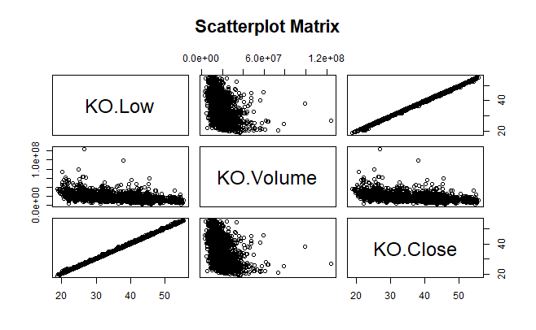

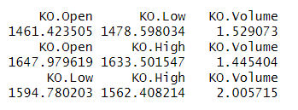
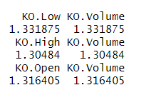
ADDRESSING MULTICOLLINEARITY
VARIANCE INFLATION FACTOR (VIF)
Initial Findings: High VIF Values For Predictor Variables (E.G., KO.Open, KO.High, KO.Low, KO.Volume)
Attempt to Reduce Multicollinearity
ATTEMPT 1
ATTEMPT 2
STOCK MARKET PRICE PREDICTION - Analyzing The Coca-Cola Company (Ticker: KO)
09

Slide 10









MODEL COMPARISIONS
LINEAR REGRESSION & LASSO – RIDGE REGRESSION
OUTPERFORMED
LINEAR REGRESSION
LASSO REGRESSION
RIDGE REGRESSION
KO.LOW + KO.VOLUME
KO.OPEN + KO.VOLUME
KO.HIGH + KO.VOLUME
STOCK MARKET PRICE PREDICTION - Analyzing The Coca-Cola Company (Ticker: KO)
10

Slide 11

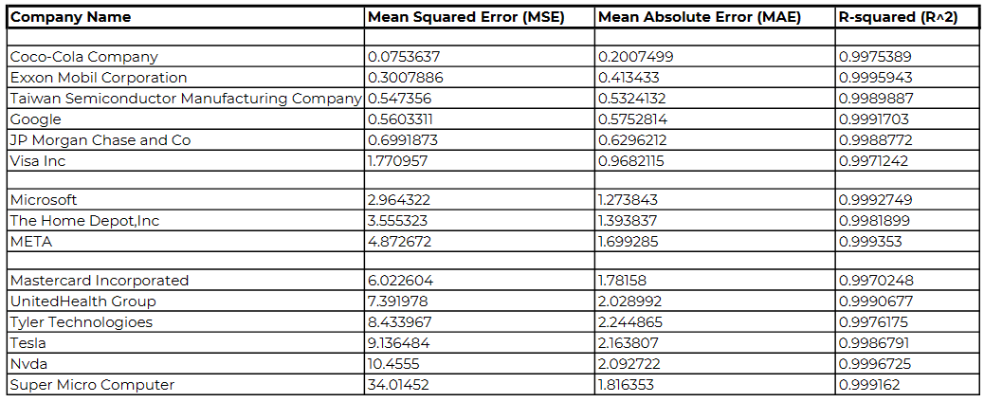
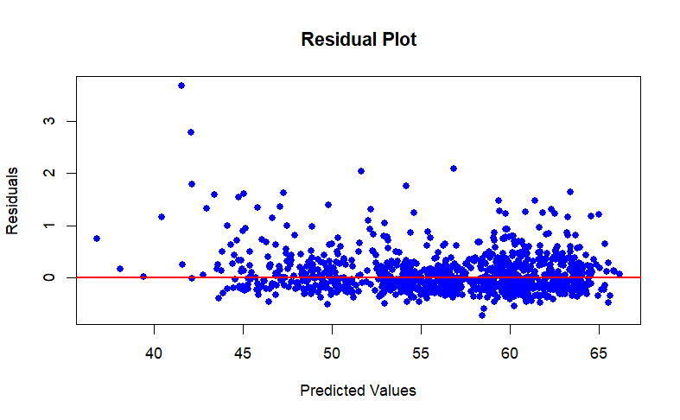
EVALUATION & RESULTS
Model Success Metric
Evaluation On Top Companies
RESIDUAL PLOT (KO)
INTERPRETATION OF IMPACT
Market Volatility
Outliers
R^2
STOCK MARKET PRICE PREDICTION - Analyzing The Coca-Cola Company (Ticker: KO)
11

Slide 12
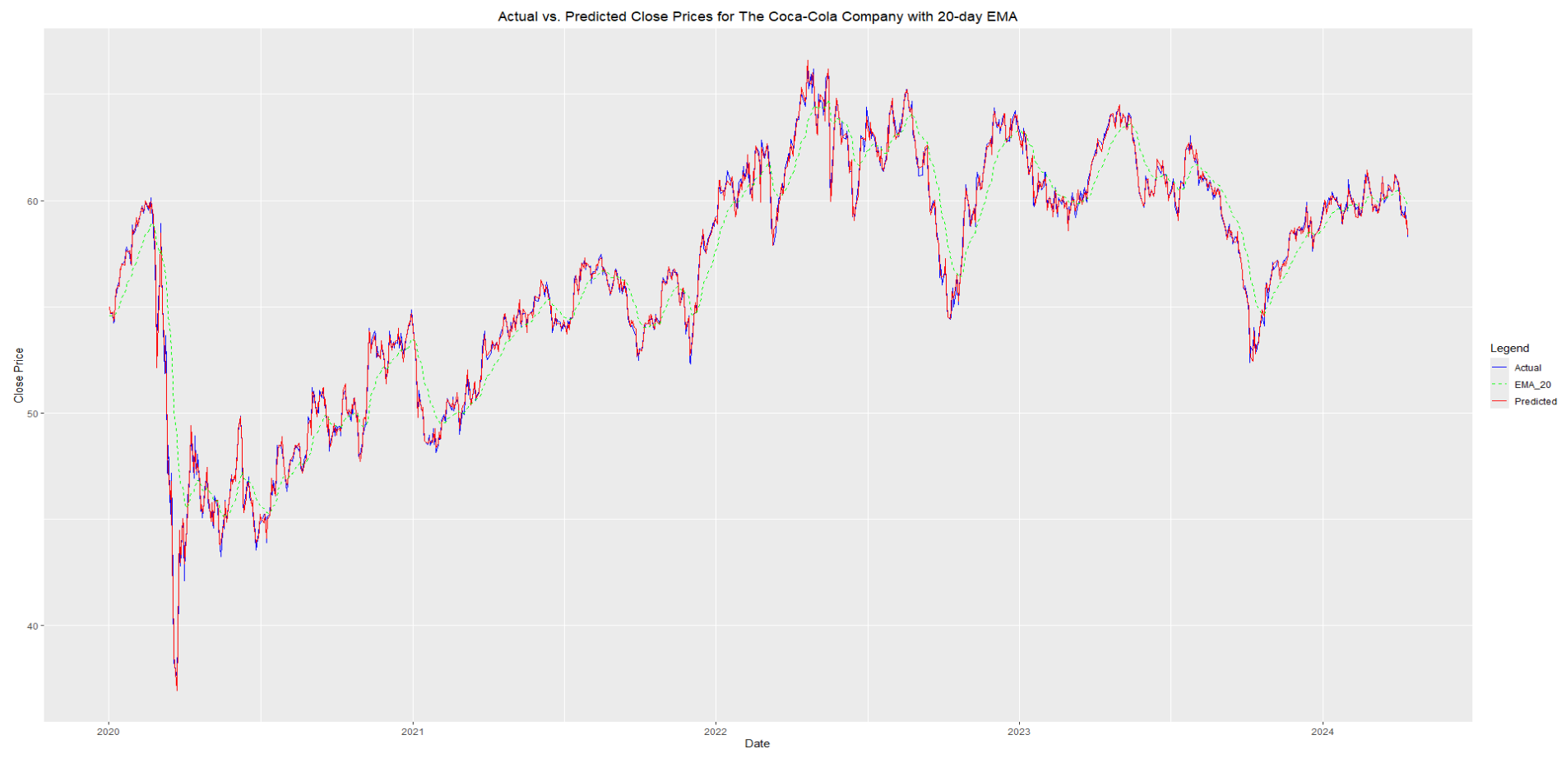
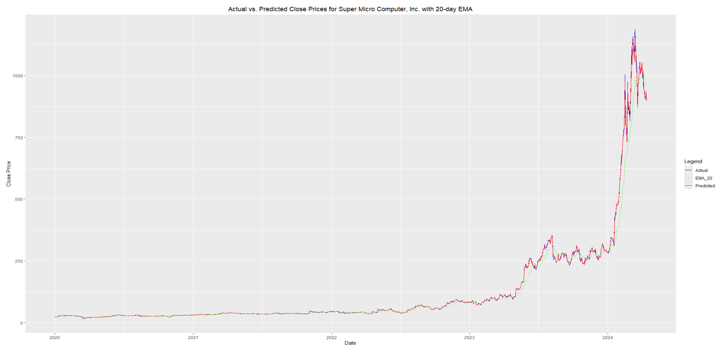
EVALUATION & RESULTS
COMPARING THE KO WITH SUPER MICRO COMPUTER
COCACOLA | SUPER MICRO COMPUTER
Volatile Stock
A Little Volatile Stock
STOCK MARKET PRICE PREDICTION - Analyzing The Coca-Cola Company (Ticker: KO)
12

Slide 13
EVALUATION & RESULTS
Actual Vs Predicted Close Prices For The Coca-Cola Company with 20-Day EMA
PREDICTED CHART
Vs
ACTUAL CHART
STOCK MARKET PRICE PREDICTION - Analyzing The Coca-Cola Company (Ticker: KO)
13

Slide 14
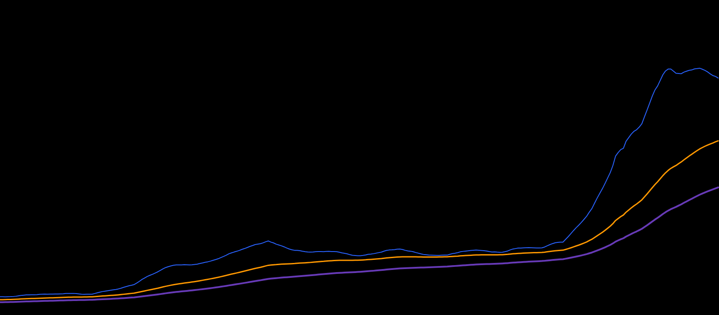
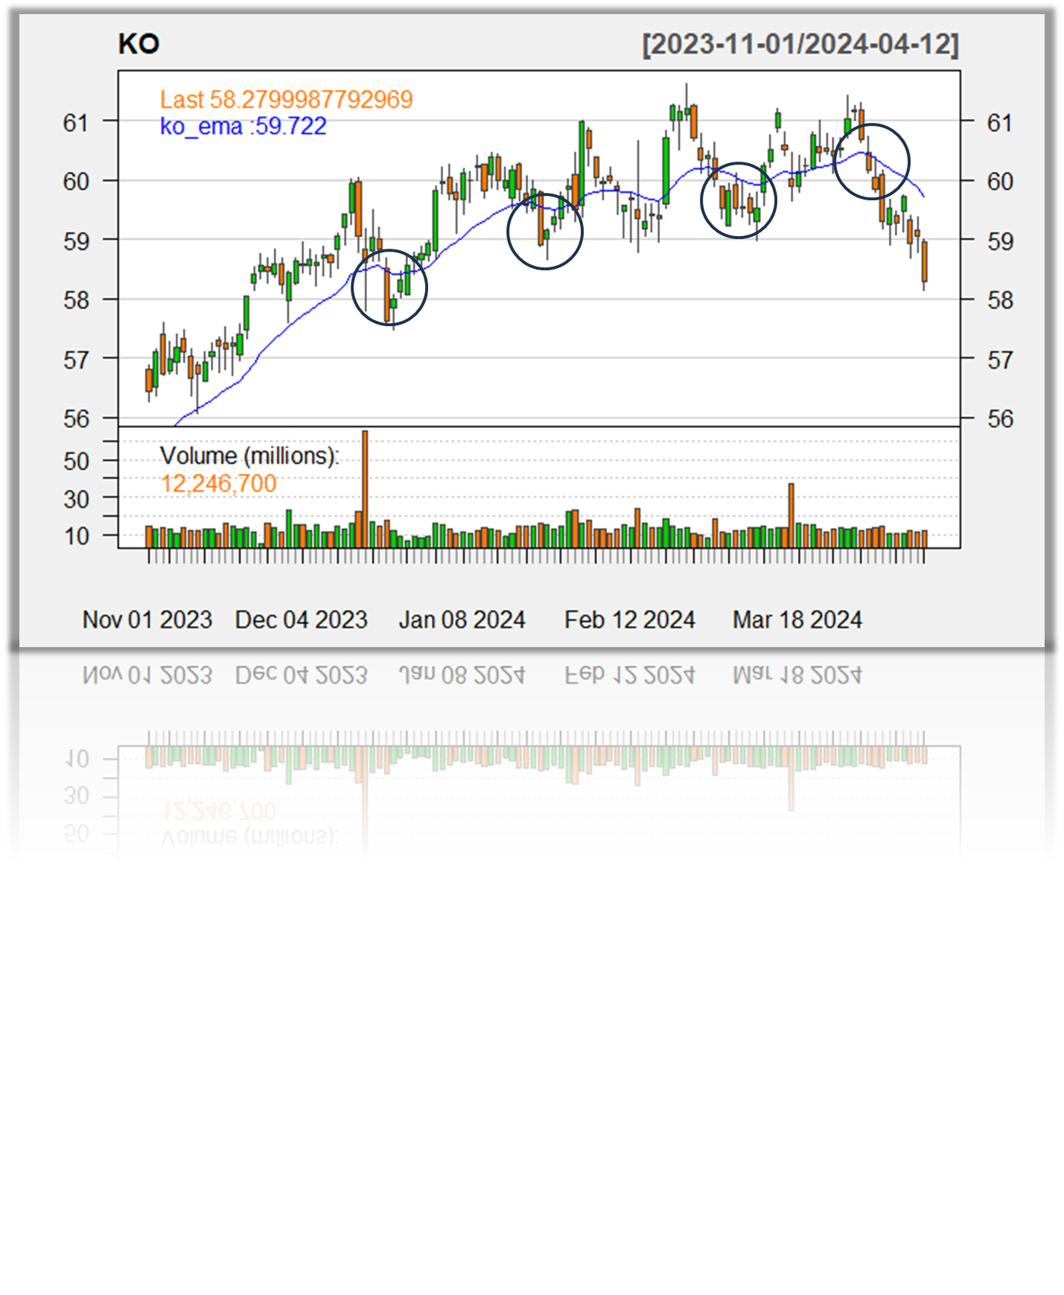
ADDITIONAL TASK
Develop a buy and sell indicator based on the predictive model to assist in investment decision-making.
Does It Work For Investors ?
Provides objective signals: Helps traders overcome emotions and biases by relying on objective criteria for decision-making.
Considerations When Using Buy and Sell Indicators:
Provides objective signals: Helps traders overcome emotions and biases by relying on objective criteria for decision-making. Confirmation: It's essential to seek confirmation from multiple indicators or other forms of analysis to validate signals before executing trades.
False signals: No indicator is infallible, and false signals can occur, especially in choppy or range-bound markets.
Market conditions: The effectiveness of buy and sell indicators may vary depending on market conditions, such as volatility and liquidity.
What Action Should We Take At This Points ?
EMA support/resistance levels provide objective entry/exit points, streamlining decision-making.
Reduced Analysis Time Instead of spending time analyzing, traders can focus on high-probability setups identified by EMA-based strategies.
STOCK MARKET PRICE PREDICTION - Analyzing The Coca-Cola Company (Ticker: KO)
06
14

Slide 15
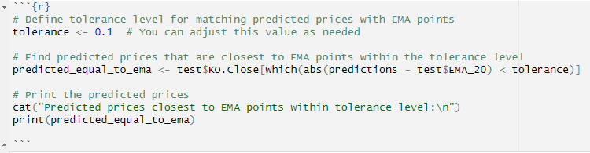
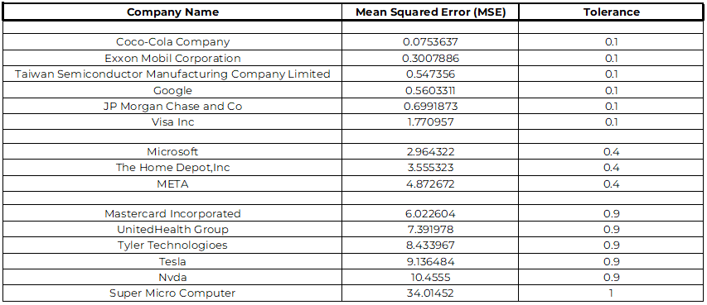
TOLERANCE ALSO BE CALLED AS “THRESHOLD”
IT REPRESENTS THE MAXIMUM ALLOWABLE DIFFERENCE BETWEEN A PREDICTED PRICE AND ITS CORRESPONDING EMA POINT.
ADJUSTING THE TOLERANCE VALUE ALLOWS TRADERS TO FINE-TUNE THE SENSITIVITY OF THEIR TRADING STRATEGY.
Example:
Suppose we set the tolerance level to 0.1 (you can adjust this value based on your preference or trading strategy).
Predicted prices within 0.1 units of an EMA point are considered to match the EMA within the specified tolerance.
Tolerance Level Based On Our Analysis For Different Stock (Volatility Focused)
OUTPUT:
Predicted Prices Closest To EMA Points Within Tolerance Level:
[1] 54.35 58.65 45.54 45.25 47.24 47.22 47.37 48.16 49.28 49.38 49.35 49.17 52.04 52.78 49.65
[16] 50.63 50.10 49.98 49.94 51.00 54.46 56.10 56.44 56.31 56.07 54.24 53.94 54.15 55.91 55.88
[31] 54.91 55.00 59.65 61.38 60.29 62.12 62.85 62.57 60.10 60.40 64.61 64.01 64.31 65.72 63.38
[46] 61.88 62.50 63.38 62.97 63.05 64.27 63.11 62.75 62.84 63.34 59.98 60.09 59.82 60.03 59.92
[61] 63.22 60.86 60.56 60.90 60.56 60.47 54.57 58.32 58.56 59.37 59.73 60.98 59.83 60.24 60.13
[76] 60.15
We’ve Total Of 76 Points From 2020 (Test Dataset)
Which Represent There’s Some Action To Be Taken On At This Points
STOCK MARKET PRICE PREDICTION - Analyzing The Coca-Cola Company (Ticker: KO)
15

Slide 16
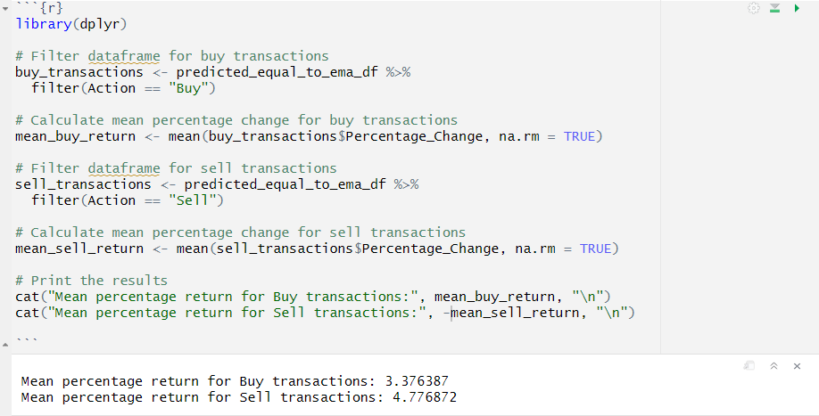
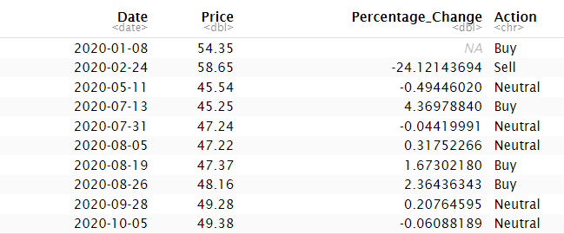
RESULTS
IT REPRESENTS THE MAXIMUM ALLOWABLE DIFFERENCE BETWEEN A PREDICTED PRICE AND ITS CORRESPONDING EMA POINT.
ADJUSTING THE TOLERANCE VALUE ALLOWS TRADERS TO FINE-TUNE THE SENSITIVITY OF THEIR TRADING STRATEGY.
Percentage Change With Dates
Average Percentage Return
Predicted Buy/Sell Indication Based on Price Change Using Tolerance Level
Mean percentage change for Buy: 3.376387
Mean percentage change for Sell: 4.776872
Highest Buy Percentage Change With Date = 8.468406
Highest Sell Percentage Change With Date = -24.12144
STOCK MARKET PRICE PREDICTION - Analyzing The Coca-Cola Company (Ticker: KO)
17

Slide 17
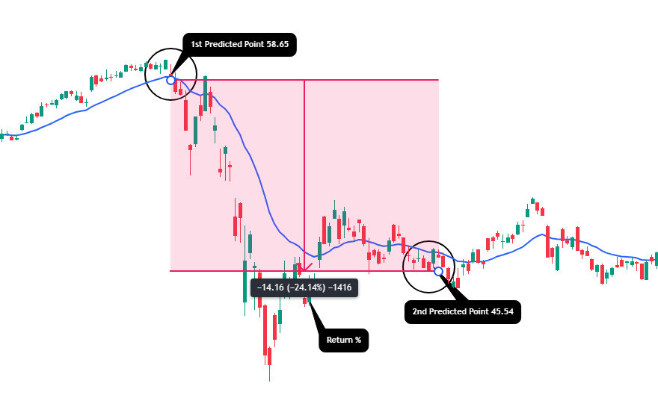


RESULTS ON DAILY CHART
IT REPRESENTS THE MAXIMUM ALLOWABLE DIFFERENCE BETWEEN A PREDICTED PRICE AND ITS CORRESPONDING EMA POINT.
ADJUSTING THE TOLERANCE VALUE ALLOWS TRADERS TO FINE-TUNE THE SENSITIVITY OF THEIR TRADING STRATEGY.
Performed Model Results On Main Chart Of KO From TradingView Platform
TradingView is a social media network, analysis platform and mobile app for traders and investors. The company was founded in 2011 and has offices in New York and London. As at 2020, the company ranks in the top 130 websites globally according to Alexa – Source Wikipedia
Launch date: September 2011
Founded: 2011
COCA-COLA (KO) – Current Market Price On TradingView
[1] 54.35 58.65 45.54 45.25 47.24 47.22 47.37 48.16 49.28 49.38 49.35 49.17 52.04 52.78 49.65
[16] 50.63 50.10 49.98 49.94 51.00 54.46 56.10 56.44 56.31 56.07 54.24 53.94 54.15 55.91 55.88
[31] 54.91 55.00 59.65 61.38 60.29 62.12 62.85 62.57 60.10 60.40 64.61 64.01 64.31 65.72 63.38
[46] 61.88 62.50 63.38 62.97 63.05 64.27 63.11 62.75 62.84 63.34 59.98 60.09 59.82 60.03 59.92
[61] 63.22 60.86 60.56 60.90 60.56 60.47 54.57 58.32 58.56 59.37 59.73 60.98 59.83 60.24 60.13
[76] 60.15
STOCK MARKET PRICE PREDICTION - Analyzing The Coca-Cola Company (Ticker: KO)
16

Slide 18
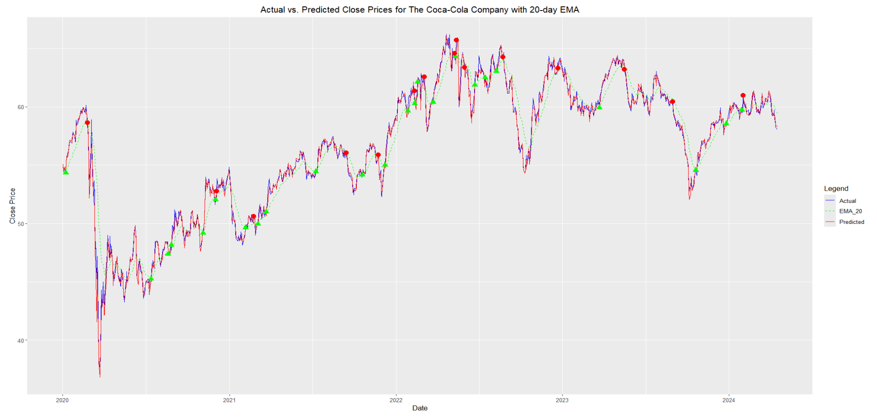
OVERALL RESULT ON PREDICTED CHART
IT REPRESENTS THE MAXIMUM ALLOWABLE DIFFERENCE BETWEEN A PREDICTED PRICE AND ITS CORRESPONDING EMA POINT.
ADJUSTING THE TOLERANCE VALUE ALLOWS TRADERS TO FINE-TUNE THE SENSITIVITY OF THEIR TRADING STRATEGY.
RED INDICATES
SELL
GREEN INDICATES
BUY
PREDICTIONS ON MAIN CHART
STOCK MARKET PRICE PREDICTION - Analyzing The Coca-Cola Company (Ticker: KO)
18

Slide 19
Buy and sell indicators are invaluable tools for traders, offering clear signals based on historical data and technical analysis.
They aid in informed decision-making, trend identification, and risk management strategies, enhancing traders' ability to navigate the market effectively.
However, it's crucial to recognize their limitations, including dependency on historical data, susceptibility to market volatility, and the risk of overfitting complex models.
By understanding these limitations and utilizing buy and sell indicators alongside other analysis techniques, traders can make more informed and strategic decisions in the ever-changing stock market landscape.
CONCLUSION

Slide 20
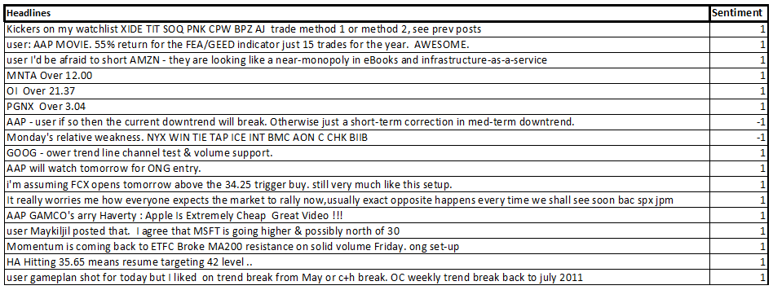



FUTURE SCOPE
INTEGRATING SENTIMENT ANALYSIS WITH BUY/SELL INDICATORS
Limitations Of Relying Solely On Historical Price Data For Decision-making
Potential Benefits Of Incorporating Sentiment Analysis, Such As Capturing Market Sentiment Shifts In Real-time And Improving The Accuracy Of Trading Signals.
Periods Of Strong Positive Sentiment Coinciding With Buy Signals, Or Periods Of Negative Sentiment Coinciding With Sell Signals.
STOCK MARKET PRICE PREDICTION - Analyzing The Coca-Cola Company (Ticker: KO)
20

Slide 21
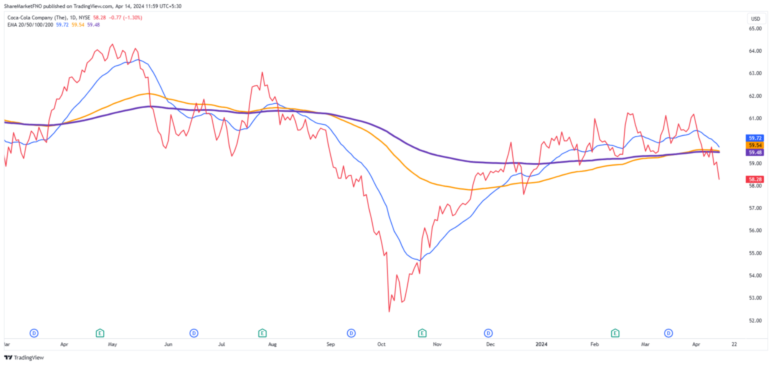
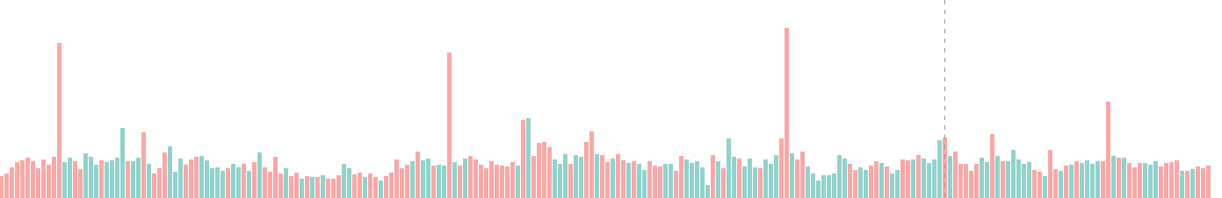
THANK YOU
Any Questions ?
STOCK MARKET PRICE PREDICTION - Analyzing The Coca-Cola Company (Ticker: KO)
STOCK MARKET PRICE PREDICTION - Analyzing The Coca-Cola Company (Ticker: KO)
08
21

